Slide 1
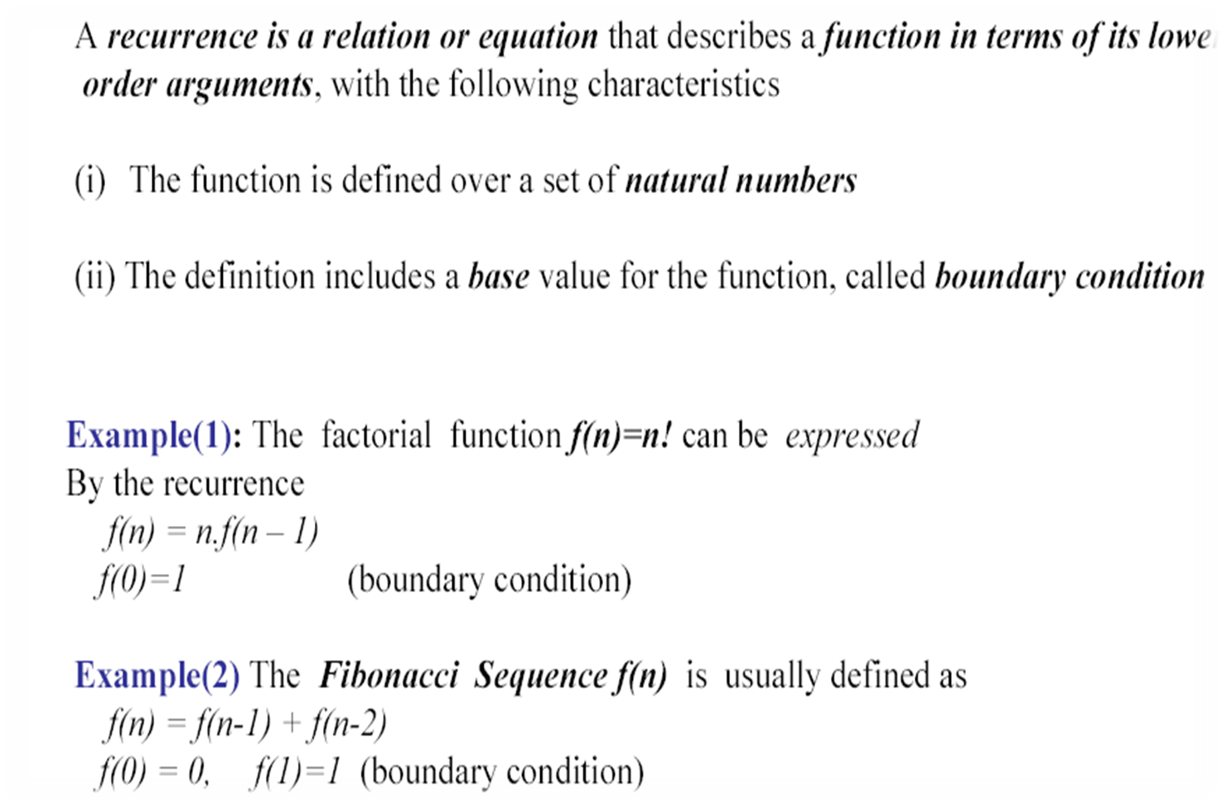
Recurrences - Definition
Adapted from slides by Dr A. Sattar

Slide 2
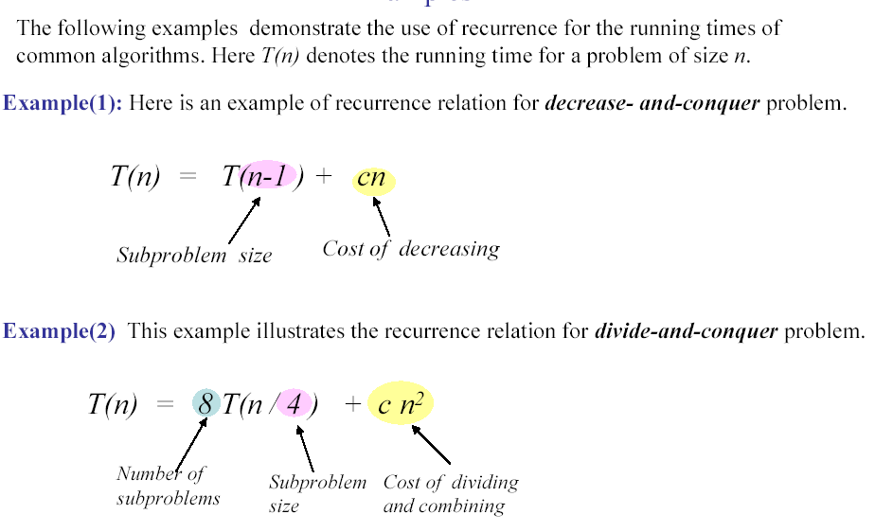
Recurrences - Examples

Slide 3
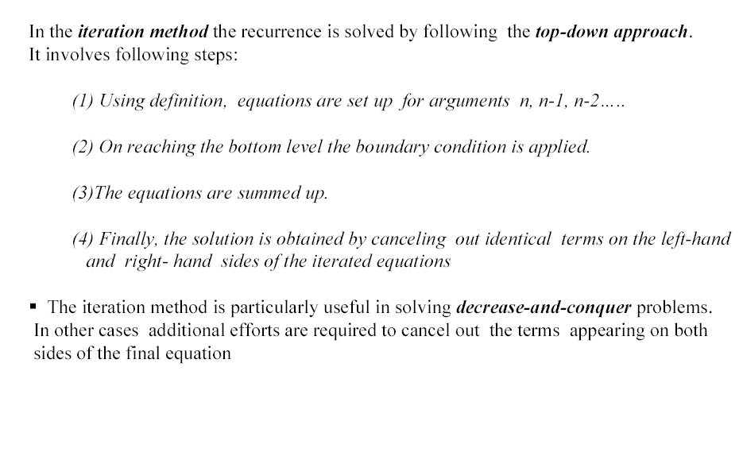
Iteration Method

Slide 4
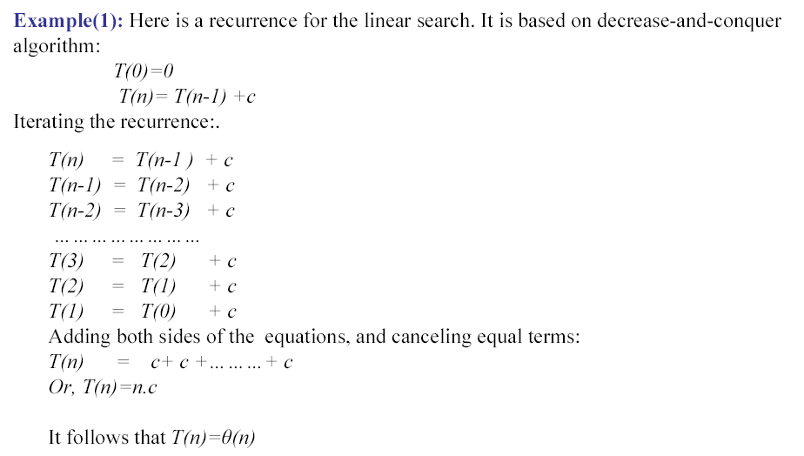
Iteration Method

Slide 5
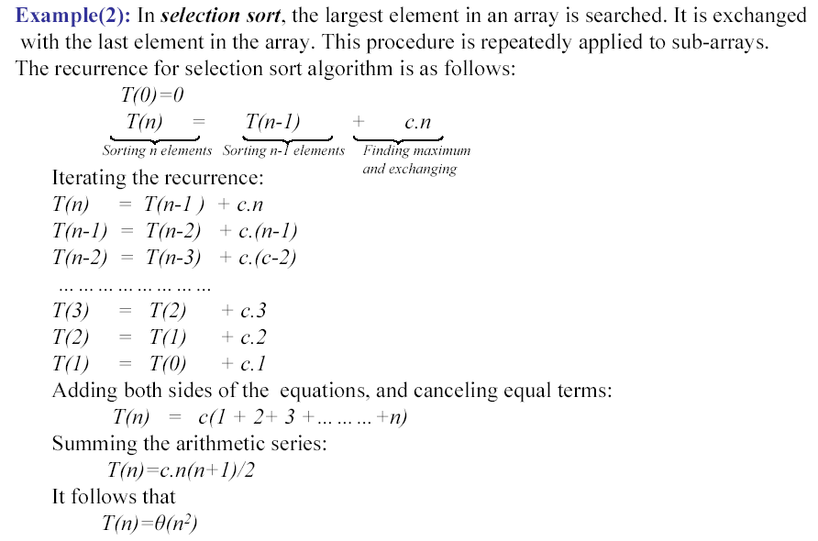
Iteration Method
Adapted from slides by Dr A. Sattar

Slide 6
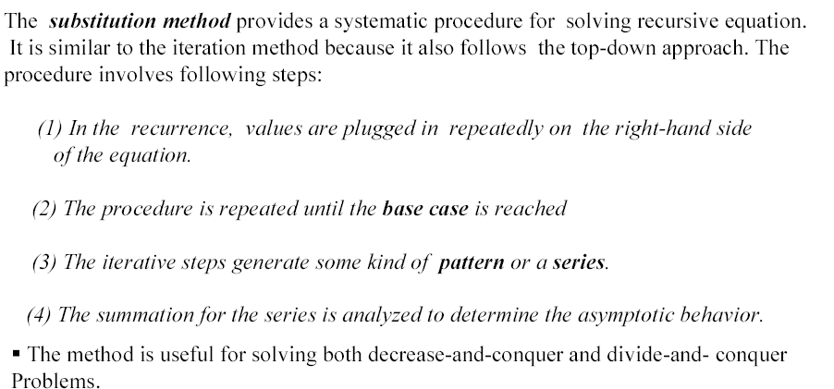
Substitution Method

Slide 7
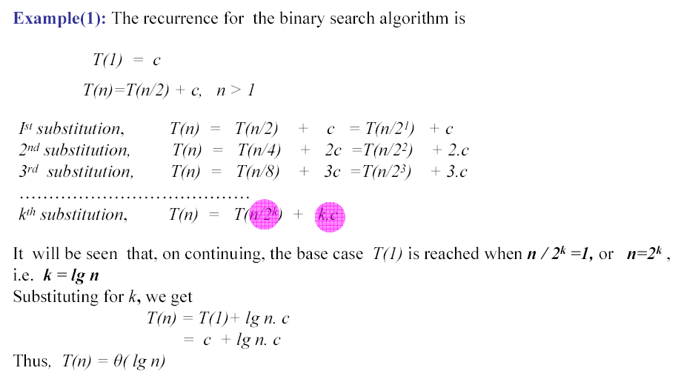
Substitution Method

Slide 8
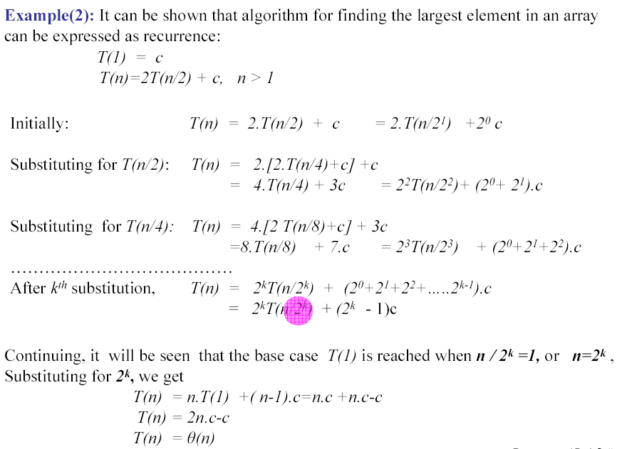
Substitution Method

Slide 9
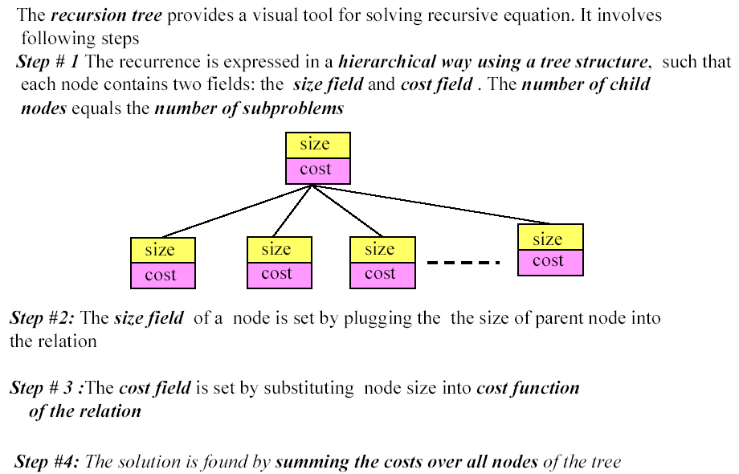
Recursion Tree

Slide 10
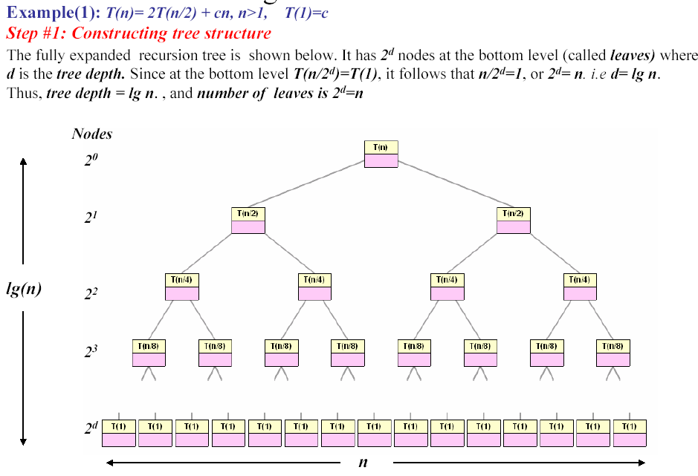
Recursion Tree

Slide 11
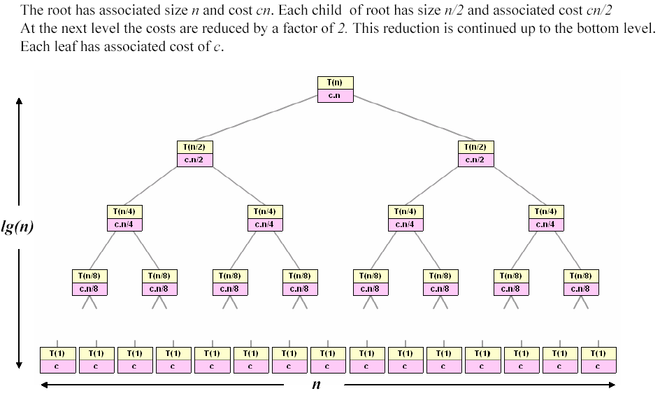
Recursion Tree
Adapted from slides by Dr A. Sattar

Slide 12
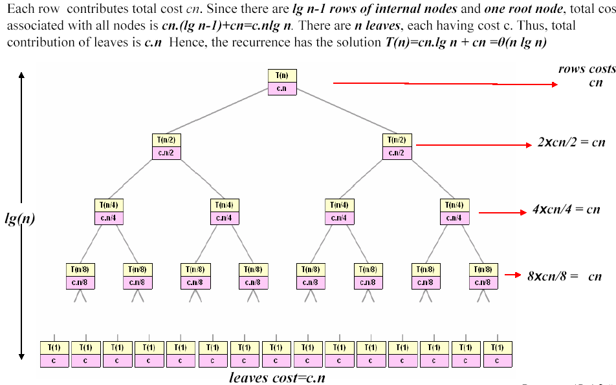
Recursion Tree

